Slide 1
Interactive Cat Toy
Notes:
Welcome to the Critical Design Review Presentation for the Interactive Cat Toy project. -Vu

Slide 2
Senior Design Group #25
Aliza Grabowski
Computer Engineering
Embedded Software
Application Software
Structural Design
Joseph Lopez
Computer Engineering
Application Software
Embedded Software
Vu Nguyen
Electrical Engineering
PCB Design
Power Supply
Embedded Software
Structural Design
Elizabeth Vargas
Electrical Engineering
Power Supply
PCB Design
Structural Design
Embedded Software
VN
Notes:
Senior Design Group #25 members are two electrical engineering students including myself Vu Nguyen and Elizabeth Vargas…
… and two Computer Engineering Students: Joseph Lopez and Aliza Grabowski

Slide 3
SPONSOR Le Phan Mechanical Engineer and Author
Notably worked with the mechanical design of the Avatar ride at Walt Disney’s Animal Kingdom
Author of “How to Design Mechanisms that last a Lifetime: Practical Applications of Gruebler’s Count”
YouTube Channel Host https://youtube.com/channel/UCEYqGvJE61nq9rFS-z_2sSA
Notes:
We are extremely thankful to have a sponsor working with us on our senior design project.
Le Phan is a … who is generously giving his time to take care of the mechanical design and 3-D printing of the chassis for our project.

Slide 4
Motivation
It is estimated that:
373 million cats around the globe are kept as pets
with approximately 93.5 million pet cats here in the U.S.A.
This provides for a large number of pet owners
looking for toys to entertain their
fun-loving felines
AG

Slide 5
Meeting a Challenge:
Cat toys are a great way to help pet owners have fun and enjoy time with their cats, while helping their beloved felines get well needed exercise.
Finding the right toy to really attract a cat into play;
however, can be a tough challenge!!
Our Senior Design Team decided to meet this challenge by building an Interactive Cat Toy (ICT) that entices cats into playtime using a variety of luring features.
AG

Slide 6
Goals & Objectives:
Design an Interactive Cat Toy that cats can be entertained by and engaged in play with for hours.
Incorporate elements into our toy that are key to domestic cat entertainment.
Work to implement the current standards and the best safety factors that we can.
Design our ICT so that it can withstand rough cat play and last for a reasonable amount of time.
JL
Notes:
For our Senior Design Project, our Goals and Objectives are to…

Slide 7
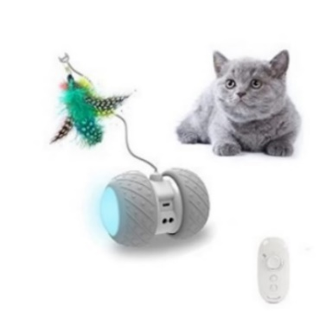
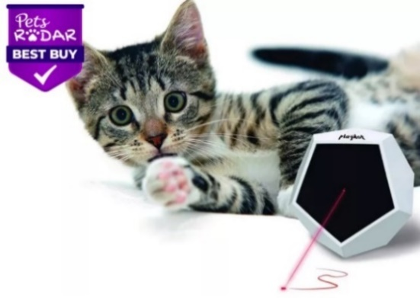
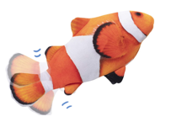
Market & Product Research:
 TOP RATED CAT TOYS 
PetDroid’s Robotic Cat Toy
Potaroma’s
Floppy Fish
Felix & Fido’s Playdot
Key Features
LED light effects
Motion
Interchangeable attachments
Laser light effects
Realistic Animal Design
Motion
Catnip Scented
EV
Notes:
We performed market and product research, to help us plan the design for our Interactive Cat Toy.
This research helped us to identify key features that were proven to entertain cats.

Slide 8
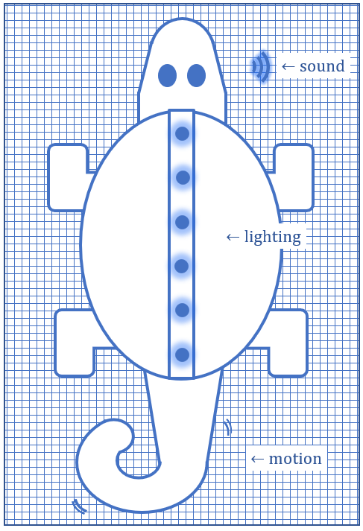
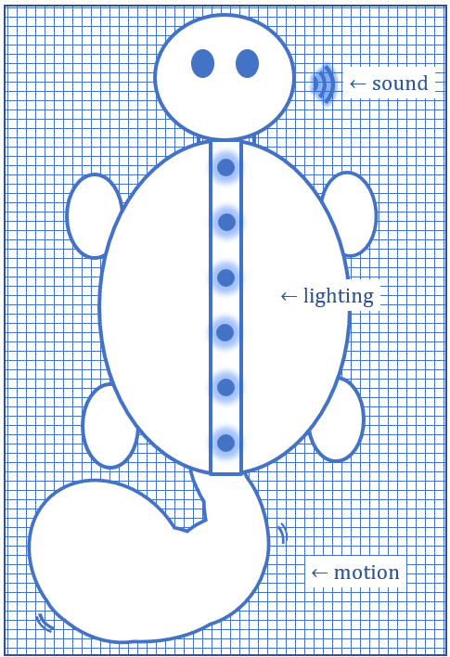
ICT Project Plan Overview:
Planned Features
Sound Effects
Lighting Effects
Toy Motion
Catnip Scenting
Interchangeable Skins
 Phone App Control
EV
Notes:
We planned to incorporate all of the key features that we identified into our Interactive Cat Toy…
… but we also take our toy design further, by adding control of select features to a phone application.

Slide 9
Requirements Specifications
Component | Parameter | Specification
Battery | Run Time on Full Battery Charge | ≈ 8 hours
Feature Components
Lighting Effect | Light Output | 4 – 6 Lumens
Lighting Effect | Illuminate Yellow Color | $≤$ 5 seconds
Speakers | Volume | $≤$ 60 dB
Motor(s) | Low Noise | $<$ 40 dB
Motion Detector | Detection Distance | $≤$ 2 feet
Phone Application | Whole System Delay Time | $<$ 30 seconds
VN
Notes:
This table lists some of our project’s requirement specifications
We have highlighted some requirements that are essential for optimal toy performance.
The LEDs for our lighting effect need to shine bright enough to be clearly seen in a room with typical daytime brightness.
Response from our motion detector should activate device features within a reasonable time.
… And our phone application should not have an excessive delay time.

Slide 10
Design
& Engineering

Slide 11
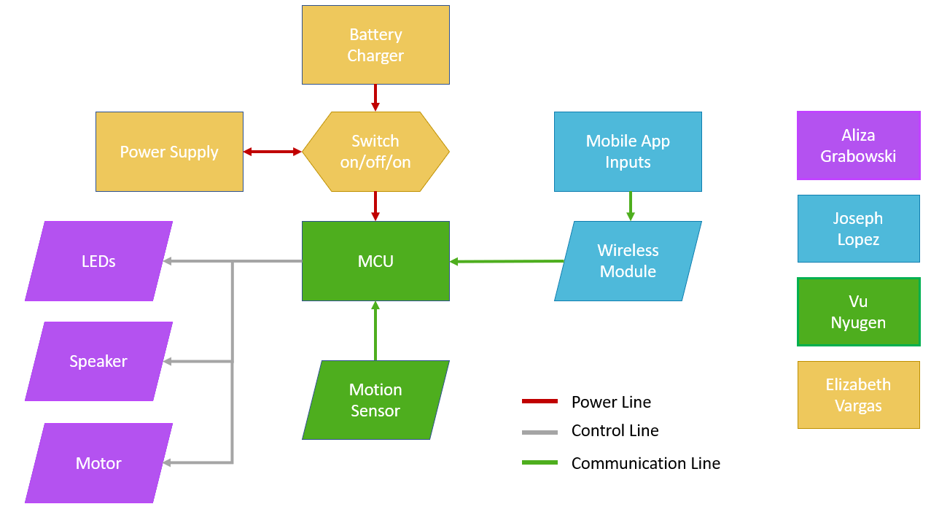
Hardware Block Diagram:
VN
Notes:
This is the Hardware Block Diagram for the ICT.
Central to our Hardware is the MCU on our PCB.
Our power supply is controlled by a switch which transitions between battery charging, being turned off and powering the toy.
The MCU is programmed to control feature component displays.
A motion sensor signals the MCU to activate the ICT from sleep mode.
A Mobile Application communicates to the MCU via a bluetooth module to allow a user to select different component display options.

Slide 12
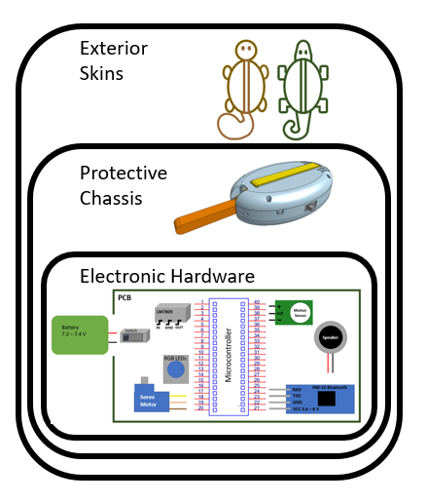
Hardware Design:
Hardware Layers
1. Exterior Skins
2. Protective Chassis
3. Electronics
VN
Notes:
The structural design of our Interactive Cat Toy includes three hardware layers.
Exterior skins will envelop a protective chassis, which will support and enclose all of the ICT’s electronics.

Slide 13
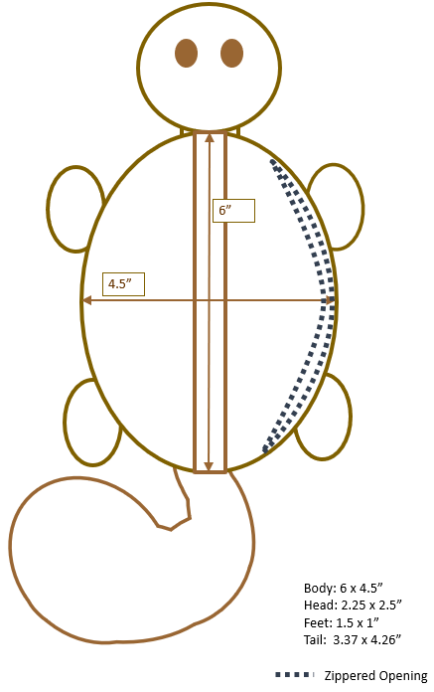
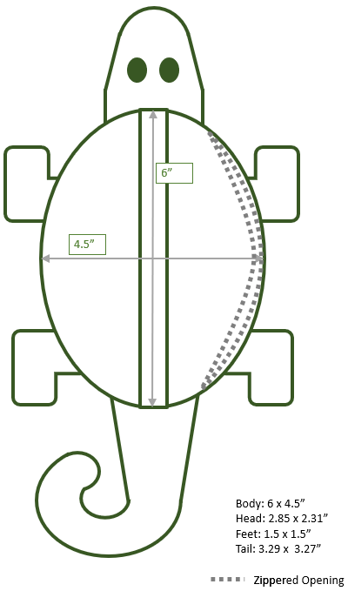
Hardware Level 1: Exterior Skins
Squirrel
Lizard
interchangeable
EV
Notes:
We decided to construct two interchangeable exterior skins for our Interactive Cat Toy.
We believe that this was a significant design decision that will provide valuable benefits to our toy:
The exterior skins are designed with the same measurements and a zippered opening, so that the chassis can be easily switched between them.
The skins are made of robust outdoor fabric to hold up to rough cat play…
… and they are also lined with cushioning to protect the chassis and electronic parts.

Slide 14
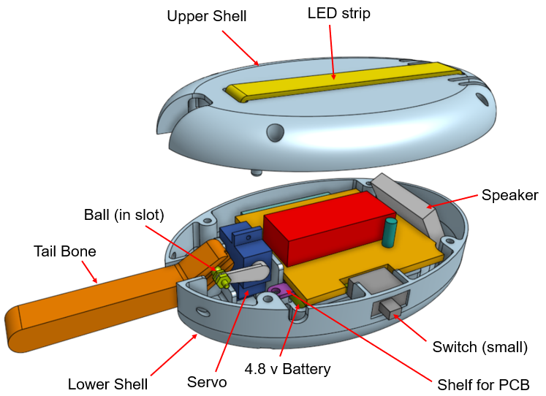
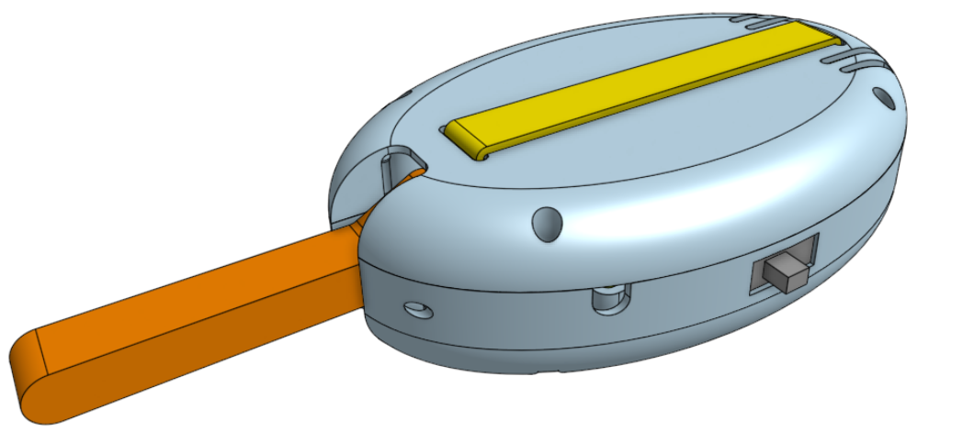
Hardware Level 2: Protective Chassis
Electronics Protection
Feature Support
Easy Fit
Mechanical Design and 3-D Printing Courtesy of our Sponsor, Le Phan
EV
Notes:
The chassis for our toy is designed to protect the electronics of the toy, to support toy features and to be easily switched between the toy’s interchangeable skins.
The mechanical design and 3-D printing of our chassis is being done by our wonderful sponsor, Le Phan.

Slide 15
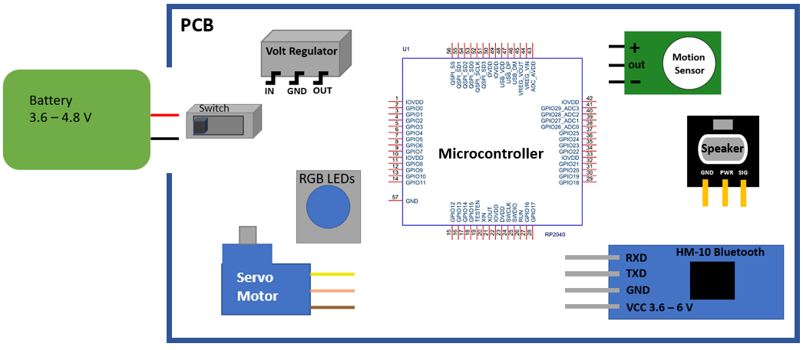
Hardware Level 3: Electronics
Notes:
Electronics for the Interactive Cat Toy include our Microcontroller and electronic feature components.
All feature components for our Interactive Cat Toy are RoHS compliant - ensuring environmentally safe products.

Slide 16
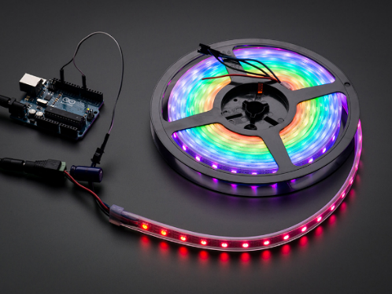
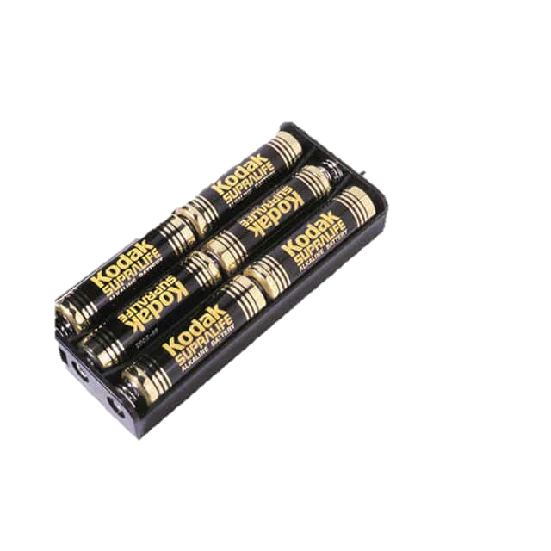
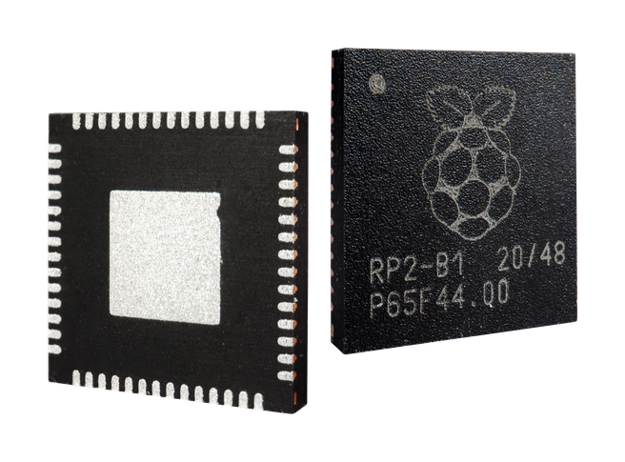
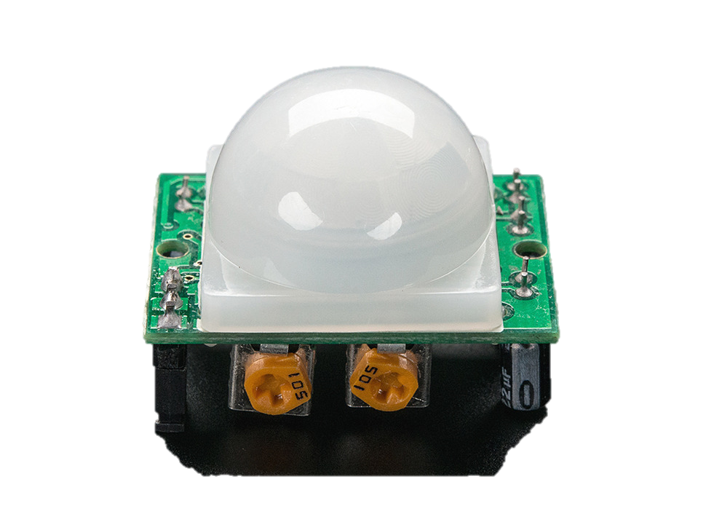
Component Selections:
Part Description | Selected Component | Vendor | ID # | Cost
Microcontroller | Raspberry Pi Pico | Digi-Key | 2648-SC0915 | 4.00
Printed Circuit Board | Self Designed PCB | PCB Way | n/a | 50.00
Wireless Module | HM-10 Bluetooth Module | Amazon | B074VXZ1XZ | 11.49
Power Source | Blomiky NiMH 4.8V 2200 mAH Battery Pack | Amazon | B0727NJ2MF | 24.99
Speaker | STEMMA Speaker | Adafruit | 3885 | 5.95
Motor | Micro Servo Motor | Adafruit | 2307 | 11.95
Lighting | NeoPixel RGB LED Strip | Adafruit | 1461 | 24.95
Motion Sensor | PIR Sensor | Adafruit | 189 | 9.95
Chassis - 3D Filament | PLA | Amazon | B014VM9724 | 23.99
Exterior Skins | Outdoor Fabric, Polyester Belting etc. | Various | Various | 40.00
VN
Notes:
The main hardware components that we selected to build the ICT are listed in this table.

Slide 17
Microcontroller
Product Description | RP-2040 | Trinket M0 | PIC18F16Q40
Vendor/ Manufacturer | Digi-Key / Raspberry Pi | Adafruit | Microchip
Vendor ID # | 2648-SC0915 | -- | --
Processor | Dual-core Arm Cortex M0+ | ATSAMD21E18 32-bit Cortex M0+ | 8-bit PIC
Dimensions | 21 mm × 51 mm | 27 x 15.3 x 2.75 mm | 7.2 x 5.30 x 1.73 mm
Operating Voltage | 1.8–5.5V DC | Up to 16V input | 1.8–5.5V DC
Watts / Amps | @ 5V ≈ 92.8mA | -- | --
Pins | 26 GPIO pins | 5 GPIO pins | 20 pins
Memory size | 264 KB SRAM, 2 MB flash memory | 32 KB RAM, 256 KB flash memory | 64 KB flash memory
Max frequency | 133 MHz | 48 MHz | 64 MHz
Programmable language(s) | C/C++, Python | CircuitPython, Arduino IDE | MPLAB IDE
Cost | $1.00 | $8.95 | $2.24
VN
Notes:
Among microcontrollers, the RP-2040 seemed to be the best option for us to use with the ICT.

Slide 18
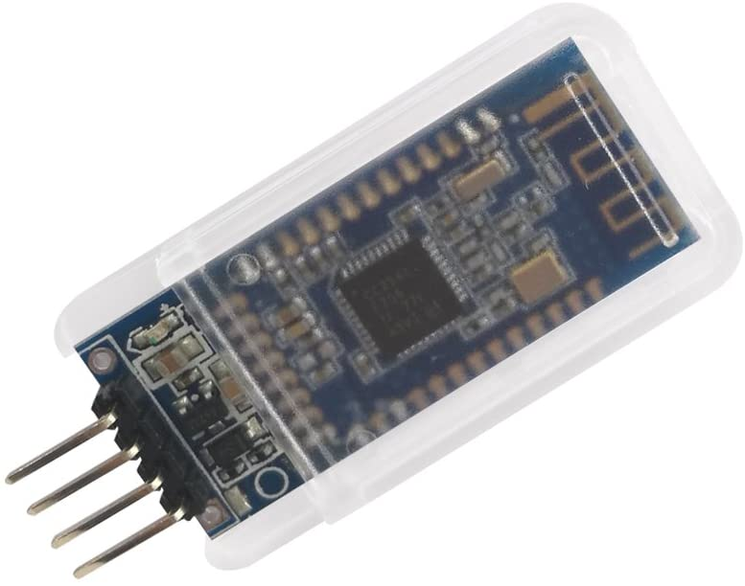
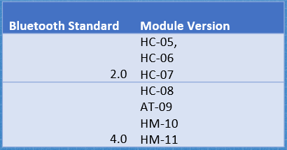
Wireless Communication:
Product Description | HC-05 | HM-10 Bluetooth Module | Bluetooth Low Energy
Vendor/ Manufacturer | Amazon / DSD tech | Amazon / DSD tech | Adafruit
Vendor ID | B01G9KSAF6 | B074VXZ1XZ | 2479
Dimensions | 26.9 x 13 x 2.2 mm | 1.5 x 0.6 x 0.1 in | 21 x 32 x 5 mm / 0.8" x 1.26" x 0.2"
Operating Voltage | 3.6 - 6V | 3.6 - 6V | 5V safe input with 3.3 Voltage regulator
Watts/Amps | 30mA | 30mA | Avg: 1.86 mA Peak: 15.2 mA
Transmission speed | 2.1 Mbps | 2.1Mbps | not listed
Operating frequency | 2.4 GHz | 2.4GHz | not listed
Phone Compatibility | Android | iPhone, Android | iPhone, Andriod
Cost | $9.99 | $11.49 | $17.50
IEEE Standard for
Low-Rate
Wireless Networks
Low Power Consumption
JL
Notes:
From available wireless communication modules on the market, we decided to go with the HM-10 Bluetooth Module.
The HM-10 Bluetooth module will provide our apps’ wireless communication with…
…the benefits of low power consumption, Android and iOS compatibility and master-slave configuration capability.
IEEE Standard for Low-Rate Wireless Networks applies to our project.
Side Note: It is recommended to use HM 4 and above for today’s cell phone compatibilities

Slide 19
Speaker Selection:
 | STEMMA Speaker | Mini Metal Speaker | Dynamic Speaker
Vendor | Adafruit | Adafruit | Digi-Key
Manufacturer | Diodes Inc | AricZhu | Soberton Inc.
Part Number | 3885 | 1890 | SP-1605
Dimensions | 37 x 30.5 x 7.2 mm 1.46” x 1.2” x .28” | Diameter: 28mm 1.1” | Diameter: 16mm .63”
Weight | 7.5g | 8g | N/A
Operating Voltage | 2.0 - 5.5 V | .25 V | .89V
Watts/Amps | 1 Watt | 0.5 Watts | 0.8 Watts
Impedance | 8 Ohm | 8 Ohm | 8 Ohm
Frequency Range | not listed | 600 Hz – 10 KHz | 300 Hz – 8 KHz
Volume Control | Screwdriver adjustable | - | -
PCB Connection | Need additional wire purchase | attached wires | attached wires
Shape | Oval / Stadium | Circle | Circle
Accessories | Class D Amplifier | - | -
Datasheet with EagleCAD File | Yes | No | No
Cost | $5.95 | $1.95 | $1.73
Notes:
For the sound feature of the ICT, we selected to use Adafruit’s Stemma Speaker with it’s included class D Amplifier.

Slide 20
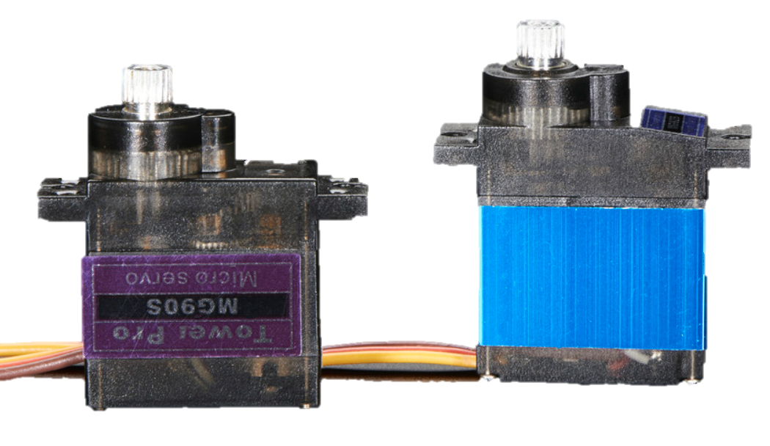
Motor Selection:
PURR-FECT!!!
Product Description | Brushless DC Motor | Micro Servo Motor | Stepper Motor
Vendor/ Manufacturer | BC Robotics | Adafruit/ Tower Pro | Digi-Key / Adafruit
Vendor ID | ROB-211 | #2307 | 1528-1366-ND
Manufacturer ID | A2212/15T | n/a | #858
Dimensions | 40 x 27.5 mm 1.73” x 1.1” length x Diameter | 1.4” x 0.5” x 1.2” | 29 x 28 mm 1.14” x 1.1” length x Diameter
Range of Motion | 360° 930 RPM/Volt | ≈ 180° | 360°
Operating Voltage | 2 - 12 V DC | 5.0 ≈ 6.6 V | 5 V DC
Watts/Amps | 109 W | not given* | not given*
Accessories | motor mount + | 3 Horns included | mounting plate
Cost | $12.95 | $11.95 | $4.95
Notes:
We selected to go with the Tower Pro micro servo motor from Adafruit to facilitate tail motion for our cat toy.
Servo motors allow for embedded code to use PWM to control positioning of the gears, giving us just what we needed to correctly simulate tail motion.
This micro servo motor is ideally sized and has robust metal gears, so it seemed purr-fect for the ICT.

Slide 21
Lighting Selection:
Product Description | NeoPixel RGBW Mini Button LEDs | 5M WS2811 RGB IP68 LEDs | NeoPixel Digital RGB LED Strip
Vendor/ Manufacturer | Adafruit | Banggood | Adafruit
Product ID | 4776 | 1346213 | 1461
Dimensions | 9.1 mm x 9.1 mm x 3.1 mm | 5.0 m | 12.5 mm x 4.0 mm x 16.7 mm
Operating Voltage | 5.0 V | 6.5 V | 5.3 V
Watts/Amps | 70 mA each | 1.0 µA | 21 W / 60 mA each
LED Used | SK6812 | WS2811 | WS2812
LED Count | 10 pack | 50 LEDs | 60 LED/meter
Individual Control / Addressable | yes | no | yes
Weight | 0.3 g | 39 g | n/a
Cost | $4.95 | $22.99 | $24.95

Slide 22
Motion Sensor Selection:
Product Description | PIR & Mini-PIR Sensors | Ultrasonic Distance Sensor | Medium Vibration Sensor Switch
Vendor/ Manufacturer | Adafruit | Adafruit | Adafruit
Product ID | 189 | 4007 | 2384
 | 4871
Dimensions | 24*32*25 mm | 45*20*15mm | 5 mm diameter by 0.2” height
 | 13.8 mm diameter
Operating voltage | 5 -20 V | 5V | none
 | 3 - 12 V
Signal output voltage | 0v –3.3V | -- | na
Current consumption | 65mA | 15mA | none
 | not given
Current when is not active | 50µA | -- | open
 | not given
Sensitivity range | 7 m /120° cone | 2cm-400cm / 15° cone | 0 ft - Tap Sensor
 | 5 m / 100° cone
Delay time | 5sec - 5min | -- | --
 | 2 secs
Working frequency | -- | 40Hz | --
Contact Time | Na | na | 2 - 2.5 ms
Cost | $9.95 | $3.95 | $0.95
 | $3.95
Notes:
For our motion sensor we decided to use a PIR sensor…
… this sensor from Adafruit has an adjustable range and a wide cone of detection.

Slide 23
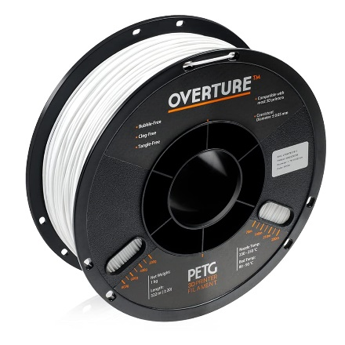
3D Printing Filament:
Product Description | PLA | PETG
Vendor/ Manufacturer | Amazon.com / Hatchbox | Amazon.com / Hatchbox
Vendor ID | ASIN: B00J0GMMP6 | ASIN: B014VM9724
Manufacturer ID | 3D PLA-1KG1.75-WHT | 3D PETG-1KG1.75-WHT
Dimensions | 1.75mm diameter X 1KG (2.2 lb)Spool | 1.75mm diameter X 1KG (2.2 lb)Spool
Color | White | White
Attributes | Sturdy | Flexible
Recommended Nozzle Temperature | 180° - 210° C 356° - 410° F | 230° - 260° C 446° - 500° F
Cost | $22.99 | $23.99
Notes:
Initially we selected PETG to print our chassis, assuming it’s slightly better flexibility would make it more robust for the ICT.
When printing, though, the chassis was too rough and fiberous… so we switched to PLA.
Side Note: PLA is made from edible material; however, processing may make it not safe for consumption. Because our chassis will be within an exterior skin we will not work to make it “Food Grade”. (ok with Dr. Wei)

Slide 24
Power Supply:

Component Power Usage Estimates
Component | Voltage (V, DC) | Current (mA) | Apprx Use min/hr | Fraction of Hour in Use | mAH Needed
Microcontroller | 1.8 – 5.5 | 93 | 60 | 1 | 93
Speaker (animal sounds) | 2 - 5.5 | 30 | 5 | 0.0833 | 2.5
Motor | 3 - 6 | 90 | 10 | 0.1667 | 15
Lighting | 5.3 | 60 | 30 | 0.5 | 30
Motion Detector | 5 - 20 | 65 | 60 | 1 | 65
Blue Tooth | 3.3 - 6 | 30 | 60 | 1 | 30
30% Margin | V + ≈ 1 V | 101 | -- | -- | 62
Total Needed | ≈ 6 - 7 V | 469 | -- | -- | 297
Current for 8 Hours |  |  |  |  | ≈2400 mAH
Battery should operate ICT for 8+ hours when fully charged.
 Enough time to entertain a cat during a typical work day.
EV
Notes:
To determine our needed power supply we added the approximate power usage for each of the toy’s electronic components plus a 30% margin
(as advised by Dr. Wei, to cover leakage current and various voltage drops)
We reasoned that the battery should power the ICT for about 8 hours on a full charge…
…this would allow enough time for entertaining cats during a typical work day.

Slide 25
Power Suppy: Battery Selection

Ni-MH Safer for
Kitty Playtime
Rechargeable Battery Comparisons
Nickel Metal Hydride (NiMH) | Lithium-Ion
Large | Small
Heavy | Light
Moderate Volatility - Pop and Burn | High Volatility – Explosive
Less Costly than Li-Ion | More Costly than NiMH
 Rechargeable batteries are standard in most electronic cat toys today.
EV
Notes:
We compared NiMH and Li-Ion rechargeable batteries as a power source for our project…
And selected NiMH due to it’s lower volatility and cost.
We selected a rechargeable battery because that is the standard for most electronic cat toys on the market today.

Slide 26
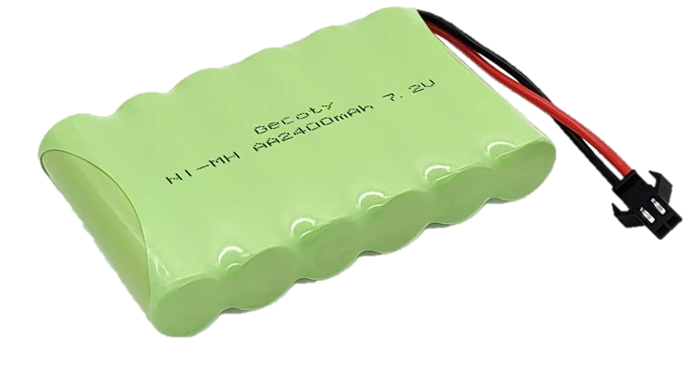
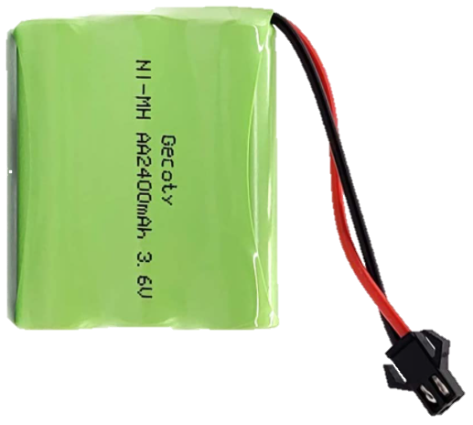
Power Suppy: Battery Selection

NiMH Battery Pack Comparison
7.2 V 2400 mAH | 6 V 2200 mAH | 4.8 V 2200 mAH | 3.6 V 2400 mAH
Too Large for ICT | Still Too Large for ICT | Good Fit for ICT | Great Fit for ICT
Too Heavy @ 200 g | Too Heavy @ ≈ 130 g | Acceptable Weight @ 100 g | Very Good Weight ≈ 70 g
Voltage Reg - Buck | Voltage Reg - Buck | Voltage Reg - Boost | Voltage Reg - Boost
Out
of Stock
Other 3.6 V NiMH Battery Packs did not offer more than 1000 mAH
EV
Notes:
For our battery selection we considered 7.2 to 3.6 V battery packs with similar current ratings.
We preferred to go with the 3.6 V pack, however, it was out of stock and other 3.6 V packs did not offer more than 1000 mAH… this would only guarantee powering the ICT for about 3 hrs.
For now we decided to go with the 4.8 V battery pack for our prototype. This pack is a good fit for the ICT with an acceptable weight at just under 100 g.
Side Note: Battery holders were too large. With the holder for even 3 AA cells being as large as the 7.2 V battery pack.

Slide 27
Power Supply: Voltage Regulation

Voltage Regulator - Boosting 3.6 or 4.8V to 5.2 V
Switching Regulator
Higher efficiency than linear regulator.
Reduces need for heat sink.
Efficiency: 95.6%
EV
Notes:
The voltage regulation circuit has been designed to accommodate boosting power from either a 3.6 or a 4.8 V battery pack, in case a 3.6 V pack should become available to us.
We employ a switching regulator because of higher efficiency and the reduction in need for a heat sink.
We boost the voltage to 5.2 V, accounting for possible for voltage loss over the circuit, in order to properly supply enough voltage to power a 5V voltage bus.
Side Notes:
Need for heat sink is reduced with switching regs b/c their transistors operate in saturation and cut-off modes (lin regs operate in active mode)
Voltage loss occurs over circuit and schotky diode between Vsys and Vbus on the PICO. We may be able to conform our features’ embedded programming to work with the direct connect of the 4.8 V battery only -- need further system testing done to determine.

Slide 28
Power Supply: Battery Charger

Design and Build?
Basic NiMH Battery Charging Circuit Components
Regulated AC-to-DC Power Supply
WEBENCH assisted design for the complex circuitry
Flyback Control → Circuit Isolation ✓
Current Control (extra important for NiMH chemistry)
Relatively simple circuit to design and test
Voltage Regulation
Design with WEBENCH
Overcharge and Thermal Protection
Multiple Techniques Require Significant Study
- Timer - Thermal Detection - Neg. Delta Voltage Detection – Trickle Charging
Sensitive monitoring for constant current essential for NiMH batteries
Out of Stock
Components
Almost A Senior Design Project in Itself
EV
Notes:
We considered designing and building a battery charger for our project, however, NiMH battery charging is significantly complex. Basic Charging Circuit Components include: Reg… Current Control… Voltage Regulation and O & TP.
Should we undertake designing and building a charging circuit for our battery, a considerable amount of time would be required to study the various charging techniques used for the process and to perform testing.
Building this circuit would almost be a SD project in itself.
… And currently, dealing with component supply issues, it would be even more difficult to compose such a circuit.

Slide 29
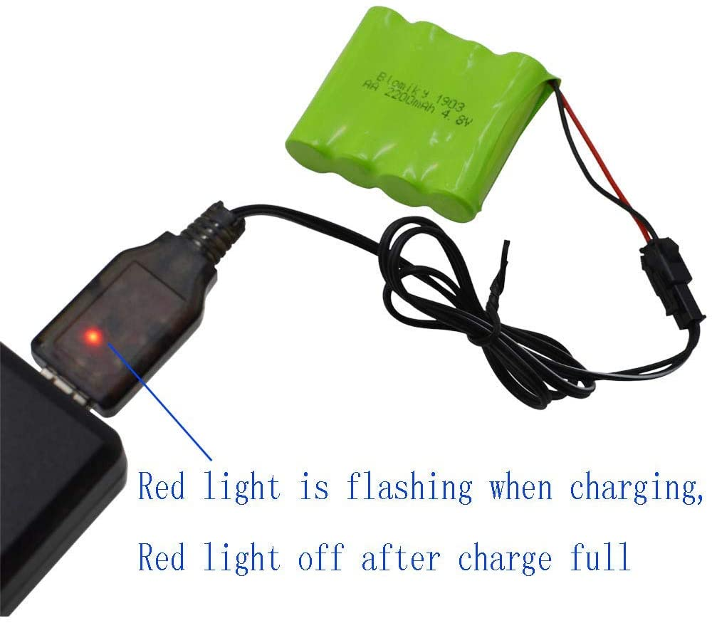
Power Supply: Battery Charger

IN STOCK
!!!
Built-in
Overcharge
Protection
EV
Notes:
Due to the complexity of designing and building an NiMH battery charger we decided to use a pre-fabricated USB charger that is sold with the battery pack we selected. (Ok’d by Dr. Wei)
…with built-in over-charge protection and an indicator light to alert when charging is complete…
…this seemed to us, to be the optimal choice of charging the battery for our project.

Slide 30
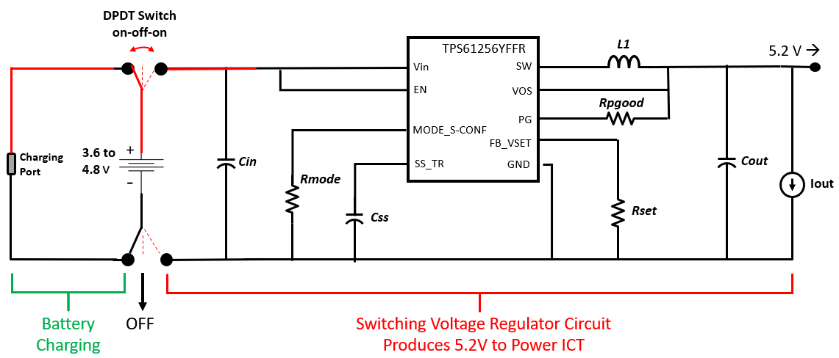
Power Supply: The Circuit

EV
Notes:
Our power supply circuit for our project is designed to be switched between three positions.
The first position allows for battery charging, the second position switches the ICT “Off”…
… and the third position enables powering the toy through a voltage regulator.
Side Note: Can be adjusted to work with 3.6 V

Slide 31
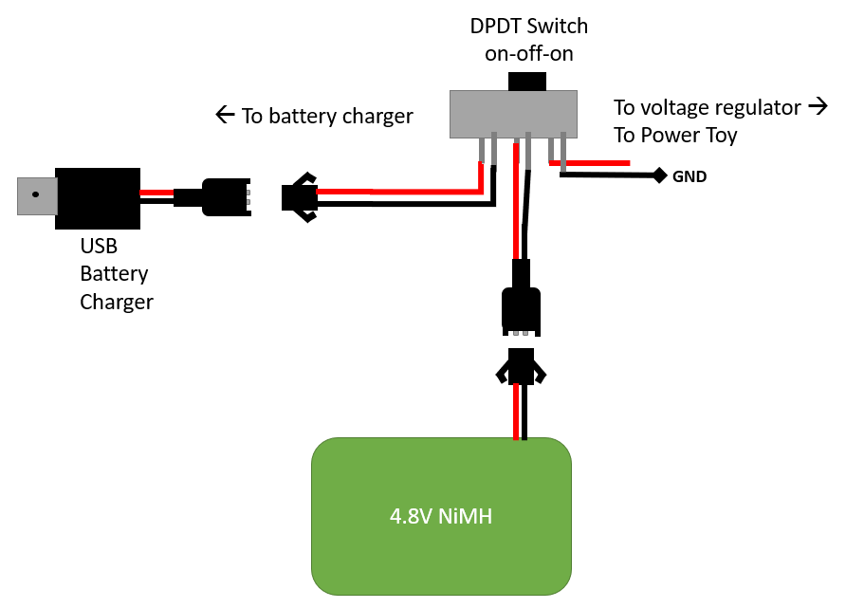
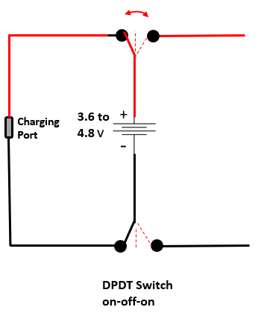
Power Supply: The Switch

EV
Notes:
Switching for our power supply circuit is realizable with a double-pole, double throw switch.
Side-notes:
Our switch has three positions on-off-on. (DPDT – 2P2T means double pole with two “on” positions
Will test to ensure isolation.

Slide 32
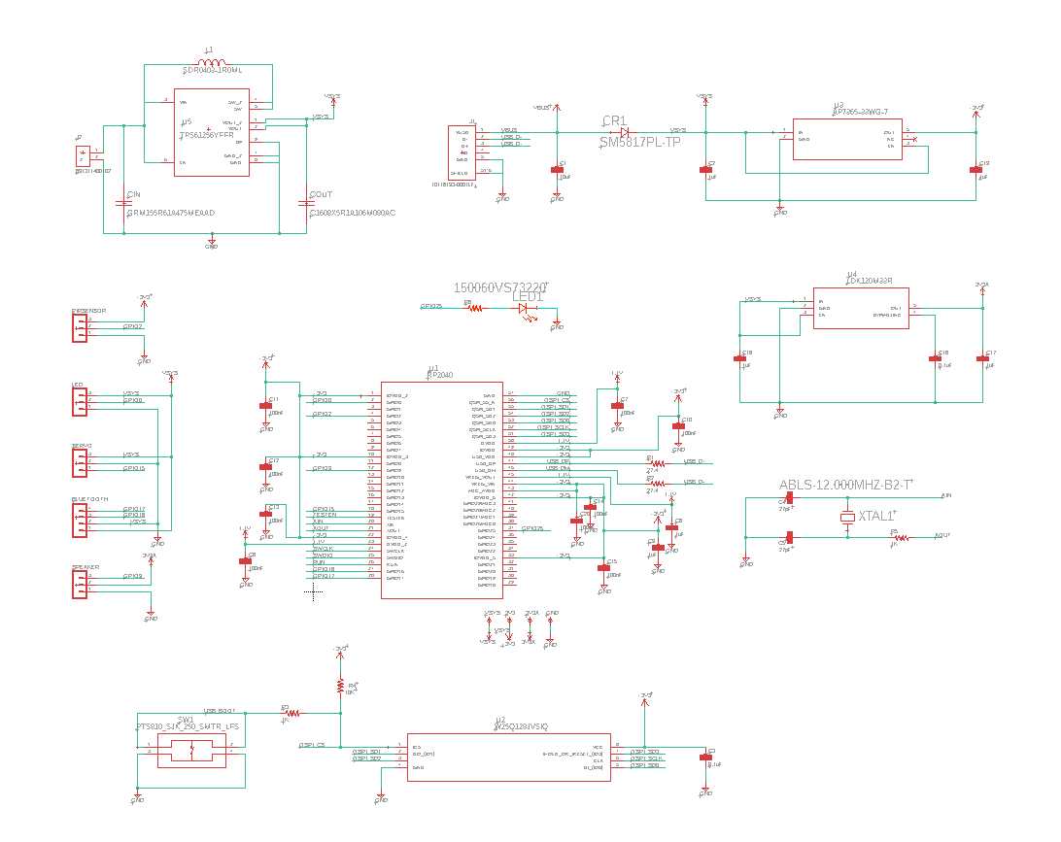
Prototype Circuit:
VN

Slide 33
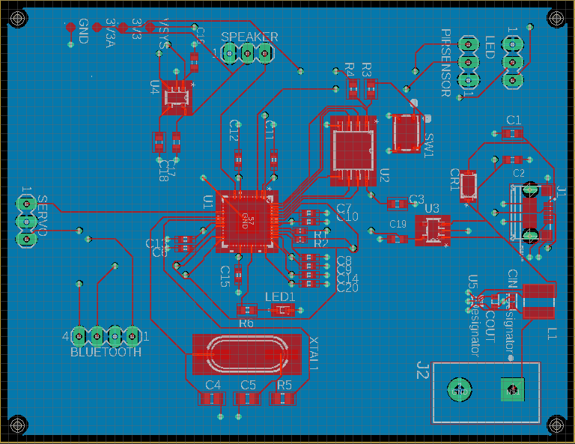
PCB Design:
IPC-2221A - Generic Standard on Printed Board Design
VN

Slide 34
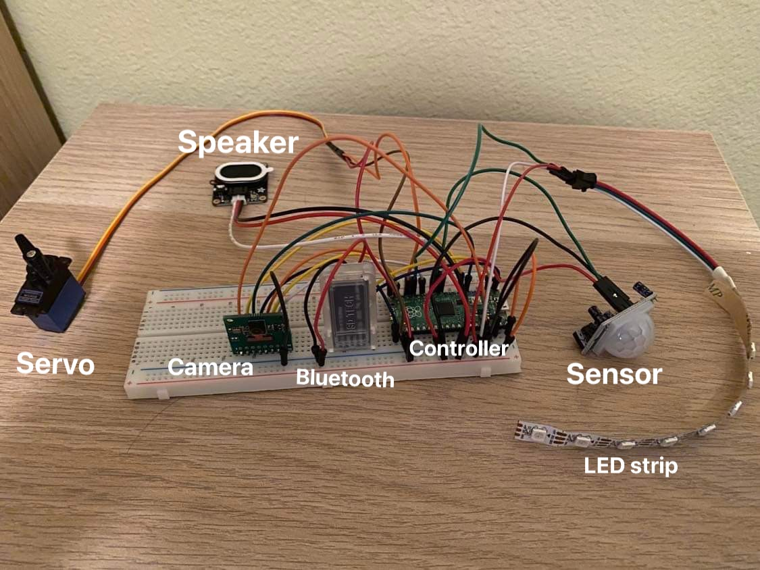
Electronics Breadboard Testing:
VN

Slide 35
Hardware Standards Apply
IPC-2221A - Generic Standard on Printed Board Design
ASTM F963-17 - Standard Consumer Safety Specification for Toy Safety
IEC 60086-1 – Primary Battery Standards
Directive 2011/65/EU - Restriction of Hazardous Substances (RoHS)
VN
Notes:
These are a few standards that apply to the hardware design of our Interactive Cat Toy.

Slide 36
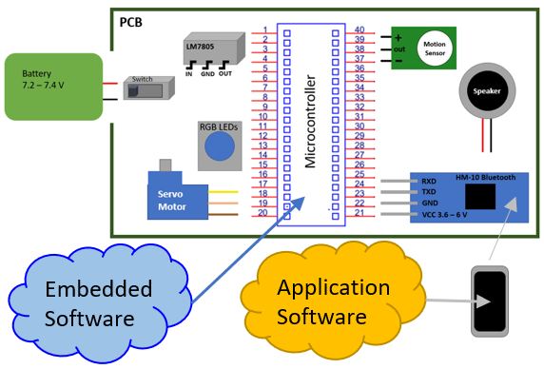
Software Design:
Software Layers
1. Application Software
2. Embedded Software
JL
Notes:
To make our project successful and fully functional we will be using application software and embedded software.

Slide 37
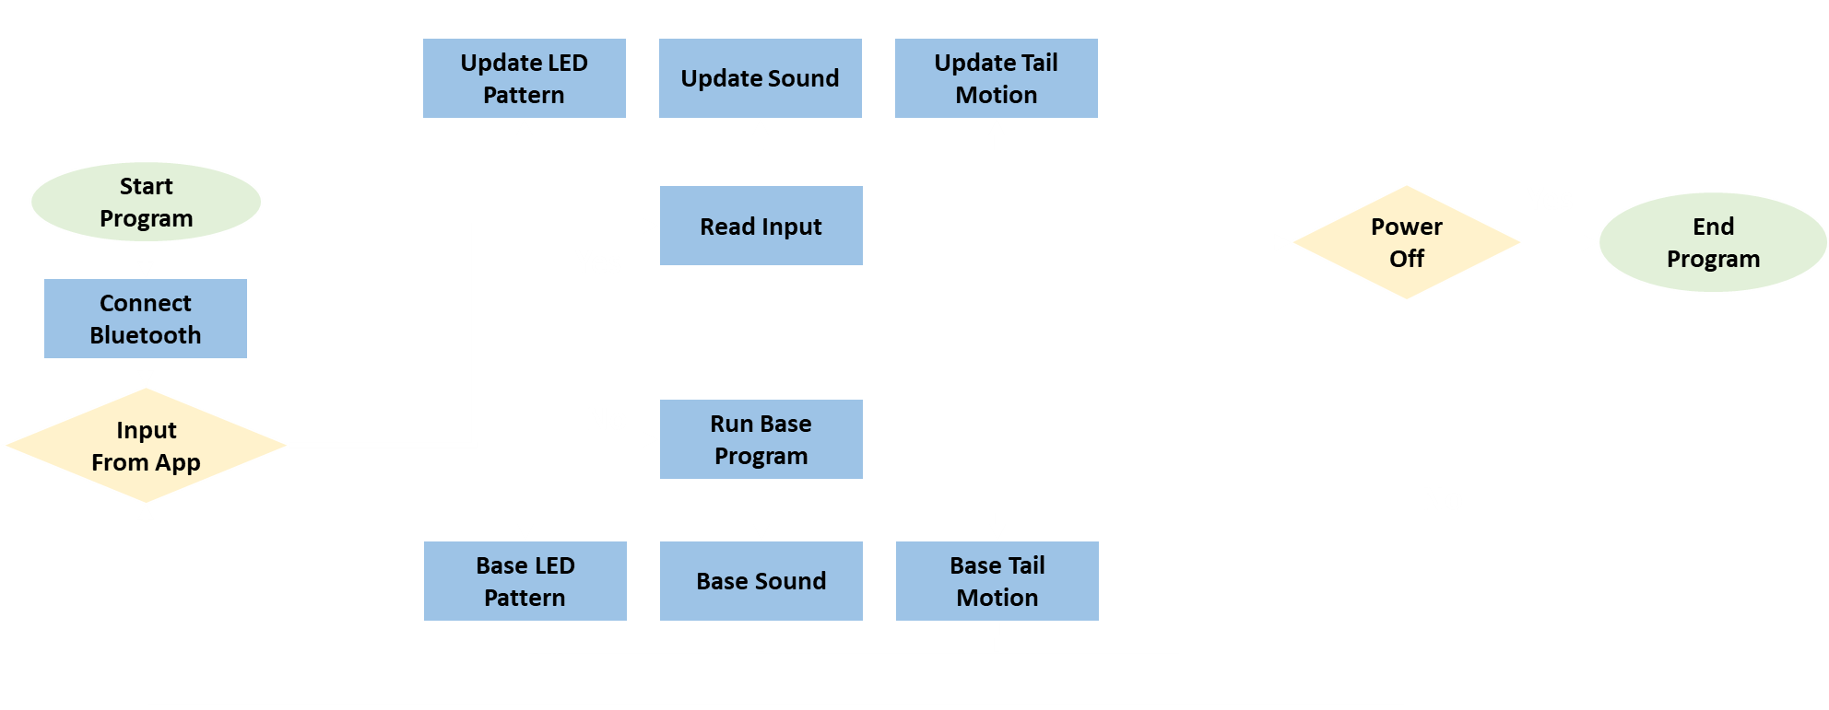
Software Block Diagram:
Symbol Table:
AG
Notes:
Script:
This software block diagram shows when the program begins it starts by connecting to the Bluetooth device.
To then check if it got any input from the mobile application.
If it doesn’t get an input, it runs the base program’s LED pattern, sound, and tail motion
If it does get an input, it updates either the LED pattern, sound or tail motion. Depending on what was selected.
After running the base program or updating the program will check if the device is off or asleep.
If it is not off or asleep it will check if there is an app input again
Otherwise the program will end.

Slide 38
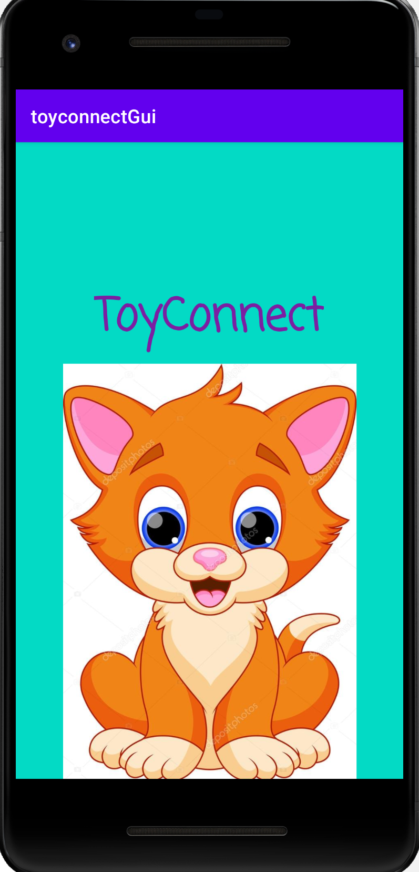
Application Software:
Development
Android Studio
Java Programming Language
Bluetooth Wireless Connectivity
JL

Slide 39
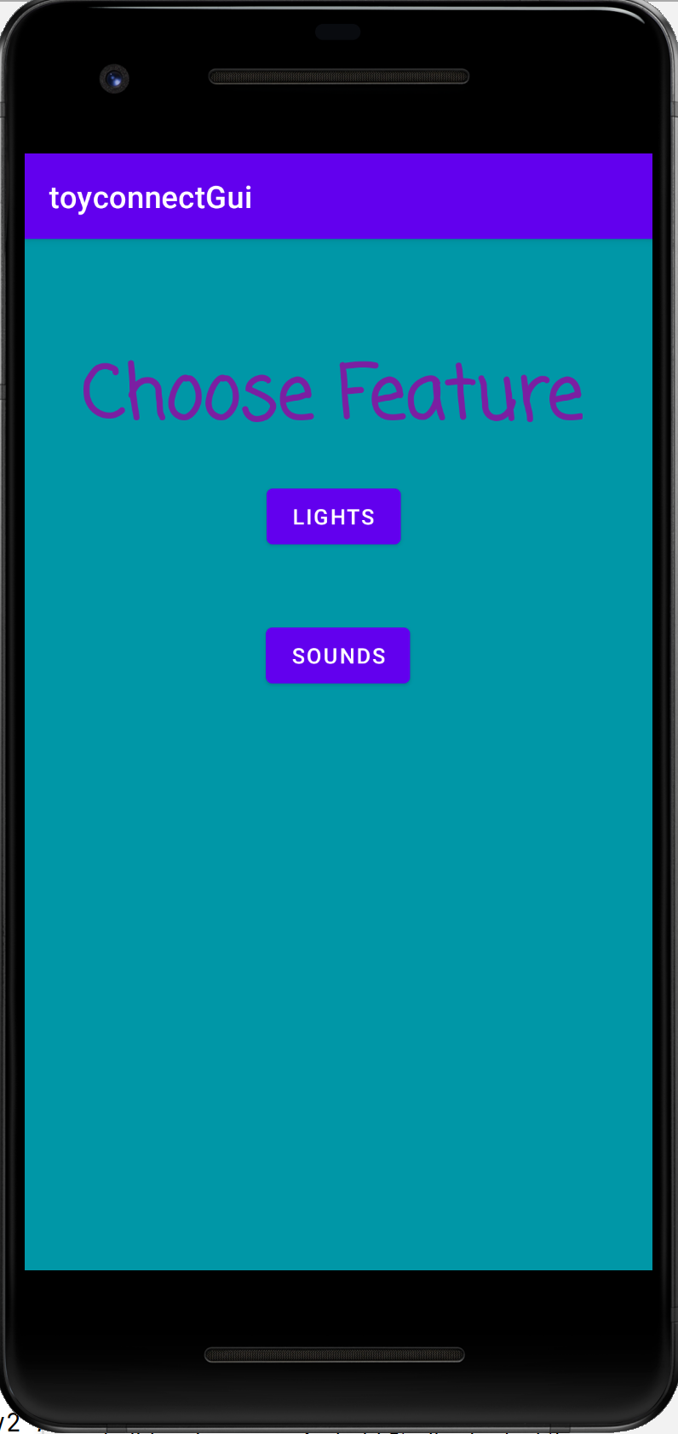
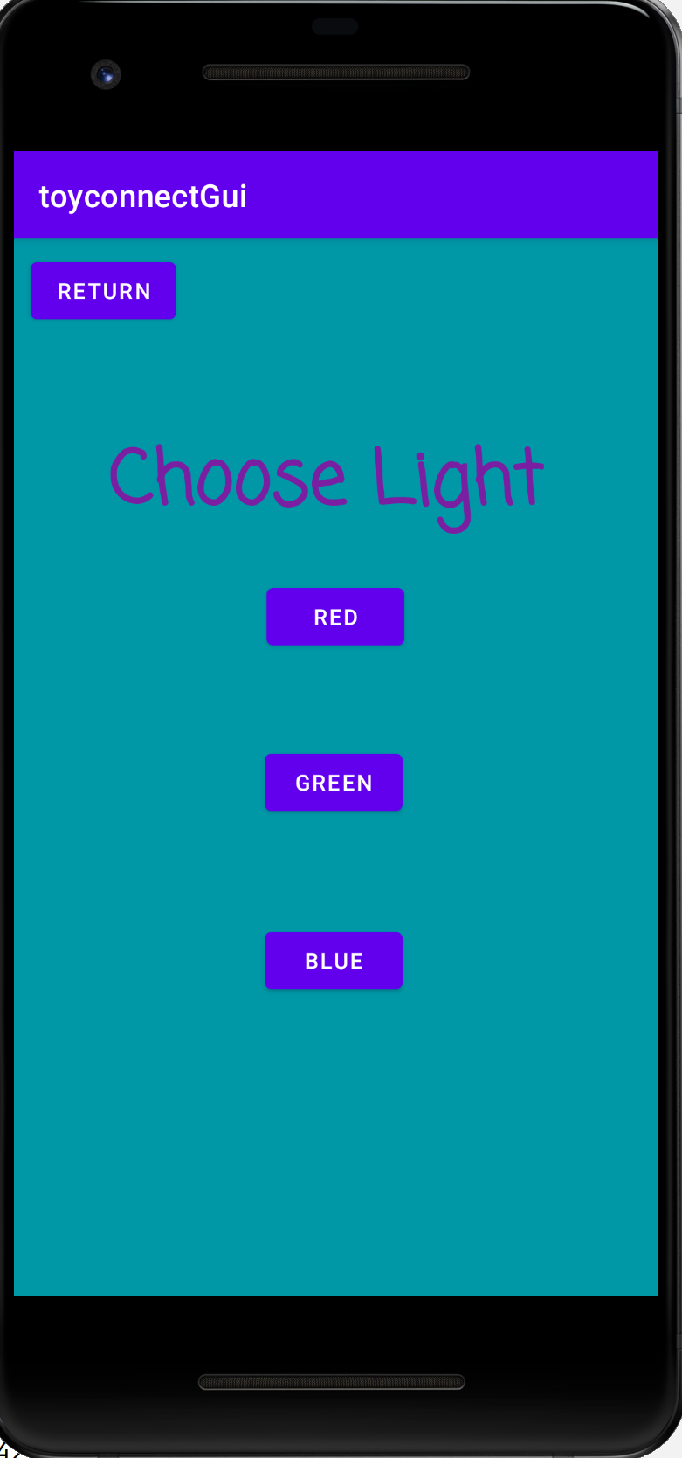
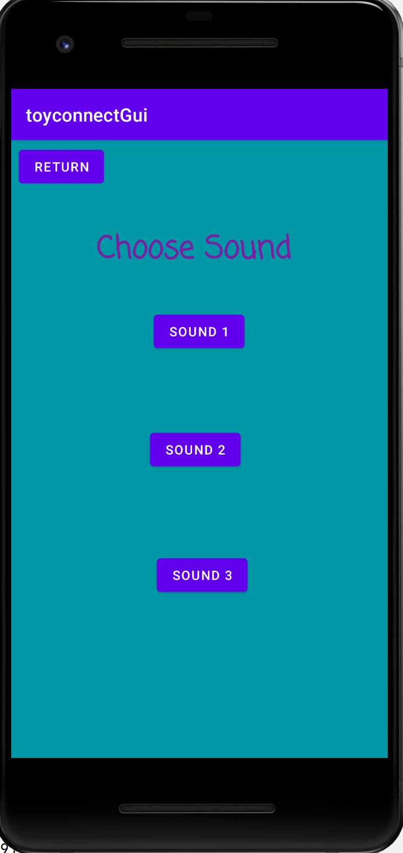
Application GUI:
Main page will present the toy features of lighting, sound, and motion
Selecting a feature will take a user to a feature page
Feature page will offer multiple exhibition options
JL

Slide 40
Application Capabilities:
Control of Select Features
for Interactive Cat Toy
3 Lighting Display Options
3 Sound Choices
3 Patterns for Tail Motion
JL

Slide 41
Application Standards:
Android Developers - Core App Quality Guidelines
Java Code Conventions
IEEE 802.15.4-2020 –
IEEE Standard for Low-Rate Wireless Networks
JL
Notes:
These are some of the standards that apply to our application development.

Slide 42
Embedded Software: Lighting Effects
The Interactive Cat Toy (ICT) Will Have WS2812 LEDs, Providing A Wide Range Of RGB Color Choices.
Base Toy LED Effect –
Simple Pattern Of One Color Going Down The LED Strip
Application LED Effect –
Option 1: Three Colors Going Down The LED Strip
Option 2: Rainbow Colors Going Down LED Strip
AG
Notes:
Script:
make an extra technical slide to mention addressability, how colors are coded, signal timing to have uniform use of 60 mA for 50 ohm resistor etc.

Slide 43
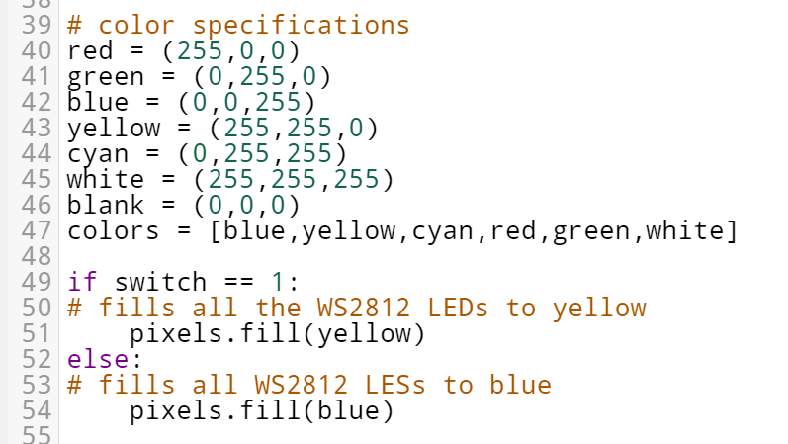
Light Coding Detail:
LEDs require current control so they will not burn out. For this we put a simple 50 Ohm resistor between our MCU and LED strip and use embedded software to limit lighting effects to 60 mA displays.
The Code Presented Describes The Basic Idea Of How We Will Be Programming The LEDs.
Red, Green, Or Blue LED Lighting Uses ≈ 20mA
White LED Lighting Uses ≈ 60 mA
AG
Notes:
Script:
With the main colors on an RGB Led (Red, Green, and Blue) consuming about 0.1 Watts of Power individually.
We then know that other colors will use more that 0.1 Watts of power, since to achieve those colors, you need a combination of the main RGB colors.
This means when programming the LEDs into our cat toy we must be mindful of how much power the LEDs are using in total.

Slide 44
Embedded Software: Tail Motion
The Interactive Cat Toy (ICT) Will Utilize A Micro Servo Motor To Provide A Tail Wagging Effect
Base Toy Tail Motion –
Simple Pattern Of Moving Up And Down At A Steady Speed
Application Tail Motion –
Option 1: Half Movement Up And Down With Full Movement Up And Down At A Steady Speed
Option 2: Quick Movement Up And Down
- Added Benefit - Motion will Help Send The Aroma Of Catnip In The Air
AG
Notes:
Script:

Slide 45
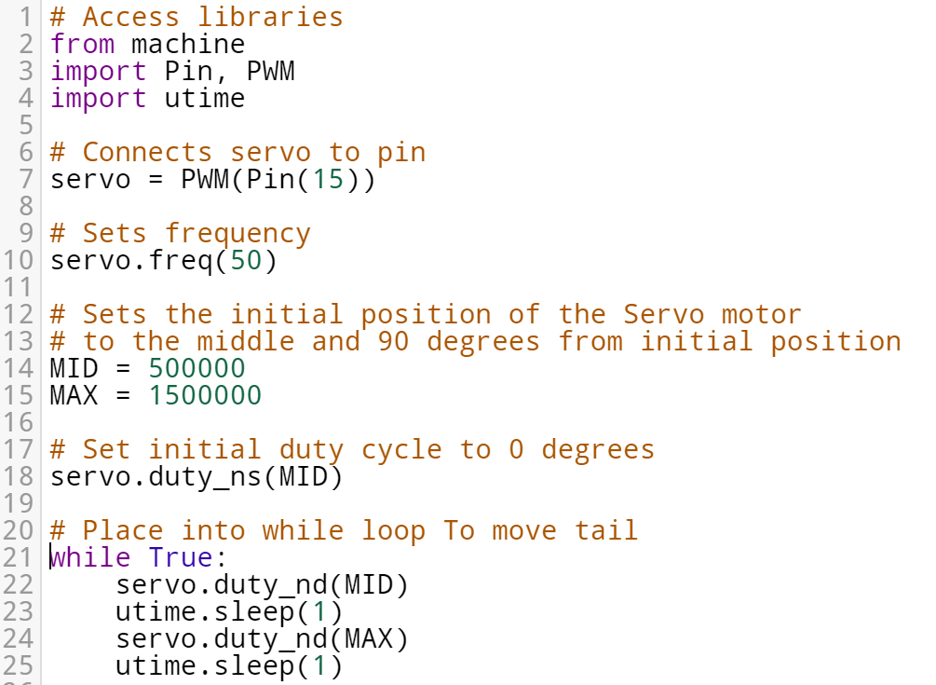
Motion Coding Detail:
In CircuitPython The Servo Motor We Will Have Its Position Grabbed Using Nanosecond, This Will Allow For Wider Range Of Angle Positions. It will Also Pause Between Each Motion.
The Code Presented Describes The Basic Idea Of How The Function On How The Tail Will Be Moved.
AG
Notes:
Script:
The position if the servo motor will be grabbed using the nanosecond method, allowing for a wider range of angle positions.
500,000 nanoseconds the potion is at 0 degrees.
1,500,000 at 90 degrees
3,000,000 at 180 degrees
And so on.
The circuitpython code to the left shows the basic idea of how our code will look.
The initial position will be set to zero degrees, using 500,000 ns.
Then continue to an infinite loop moving the tail from 0 degrees to 90 degrees, pausing for a minute between each motion.

Slide 46
Embedded Software: Sound Effects
With A Speaker The Interactive Cat Toy (ICT) Will Be Able To Make Many Sounds That Entice A Cat
Base Sound–
Simple Sound Of A Bird Chirping On Loop
Application Sound–
Option 1: Sound Of A Bug Flying
Option 2: Sound Of A Squirrel Chattering
Adafruit STEMMA Speaker
AG
Notes:
Script:

Slide 47
Sound Coding Detail:
To Get Sound Emitted From The Speaker The Code Must First Decode The mp3 File. Which Is Just A Static Array Of Numbers.
The Code Presented Describes The Basic Idea Of How The Function On How The Music Will Played.
AG
Notes:
Script:
For CircuitPython to be able to emit sound from the speaker.
We have to decode the mp3 file into a static array of numbers.
After the mp3 file is decoded, we can play the sound through the speaker endlessly through a infinite while loop.

Slide 48
Embedded Software: Sensor
A Sensor Will Establish The Ability For “Sleep” Mode. This Will Allow the Battery Life To Last Longer.
With No Interaction From A Cat For A Short While The Interactive Cat Toy (ICT) Will Switch To A “Sleep” Mode.
When The Cat Triggers The Sensor, The Sensor Will Send A Message To The Program To “Wake Up” And Continue the Base Toy LED Pattern, Tail Motion, And Sound Effects.
!
Z
Z
Z
Z
AG
Notes:
Script:

Slide 49
Administration
Business and paperwork

Slide 50
Work Distribution:
Team Member | Structural Design | PCB Design | Power Supply | Application | Embedded Software
Aliza Grabowski | S |  |  | S | P
Joseph Lopez |  |  |  | P | S
Vu Nguyen | S | P | S |  | S
Elizabeth Vargas | P | S | P |  | S
P = Primary S = Secondary
EV
Notes:
Our Work Distribution Table represents how work for our project was shared among our group members.
P distinguishes the Primary and S the secondary members who are responsible for an area of work within our project.

Slide 51
Budget & Financing:
Bill of Materials, BOM
Part # | Part Description | Vendor | ID # | Cost
1 | Microcontroller | Digi-Key | 2648-SC0915 | 4.00
2 | PCB | PCB Way | TBD | 50.00
3 | Gecoty NiMH 7.2V Battery Pack | Amazon | B0727NJ2MF | 16.00
4 | STEMMA Speaker | Adafruit | 3885 | 6.00
5 | Micro Servo Motor | Adafruit | 2307 | 12.00
6 | NeoPixel RGB LED Strip | Adafruit | 1461 | 25.00
7 | Squirrel & Lizard Skins | Various | n/a | 40.00
8 | PETG 3D Printer Filament | Amazon | B014VM9724 | 24.00
9 | HM-10 Bluetooth Module | Amazon | B074VXZ1XZ | 12.00
10 | PIR Sensor | Adafruit | 189 | 10.00
Total Cost |  | 199.00
EV
Notes:
The cost to build our Interactive Cat Toy came in at just under $200.
Our project has is being fully funded by our group members…
…having each student agreeing to pay one-fourth of the costs for the project.

Slide 52
Current Progress:
EV
Notes:
Our current progress to date has brought us to within approximately 60% completion of our Senior Design Project.
While we still have a lot of work to do to get our Interactive Cat Toy fully operational, we believe that we have made good progress and will be able to finish on time.

Slide 53
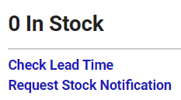
Design Constraints:
Battery Size vs. Safety - NiMH safer, but heavy and large
Components Fitting into Chassis
Components not working the way we anticipated
Out of Stock components due to Pandemic
VN

Slide 54
Significant Design Decisions:
Throughout The Initial Interactive Cat Toy (ICT) Design Pitch, Our Group Made An Effort To Truly Understanding A Cat’s Likes And Dislikes.
We Also Took Into Consideration The Power Consumption And Size Of The Toy.
Decisions Kept:
Retaining The Size Of Our Cat Toy To A Relatively Small Frame – Less Than A Foot
Mobile Application – More Options Allow A Cat To Stay Entertained
Changes Made:
A Laser to LEDs – This Change Was Made Due To The Size Of A Laser And The Assembly Of All Of Our Other Functions.
A Squirrel skin to Custom Interchangeable Skin – Though Its Not Hardware Related, Our Team Thought This Would Be A Fun Touch
AG
Notes:
Script:

Slide 55
Next Steps:
Test PCB connections with power supply, switching and components.
Refine component fittings, chassis design and exterior skin patterns.
Refine embedded programming for multiple feature expressions
Complete phone application GUI and ensure functioning control of toy features through Bluetooth wireless communication.
Ensure ICT meets requirements specifications.
JL

Slide 56
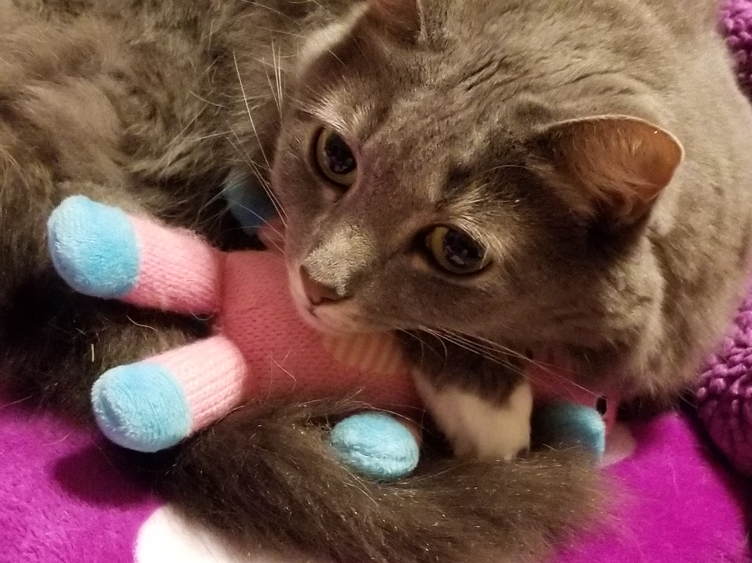
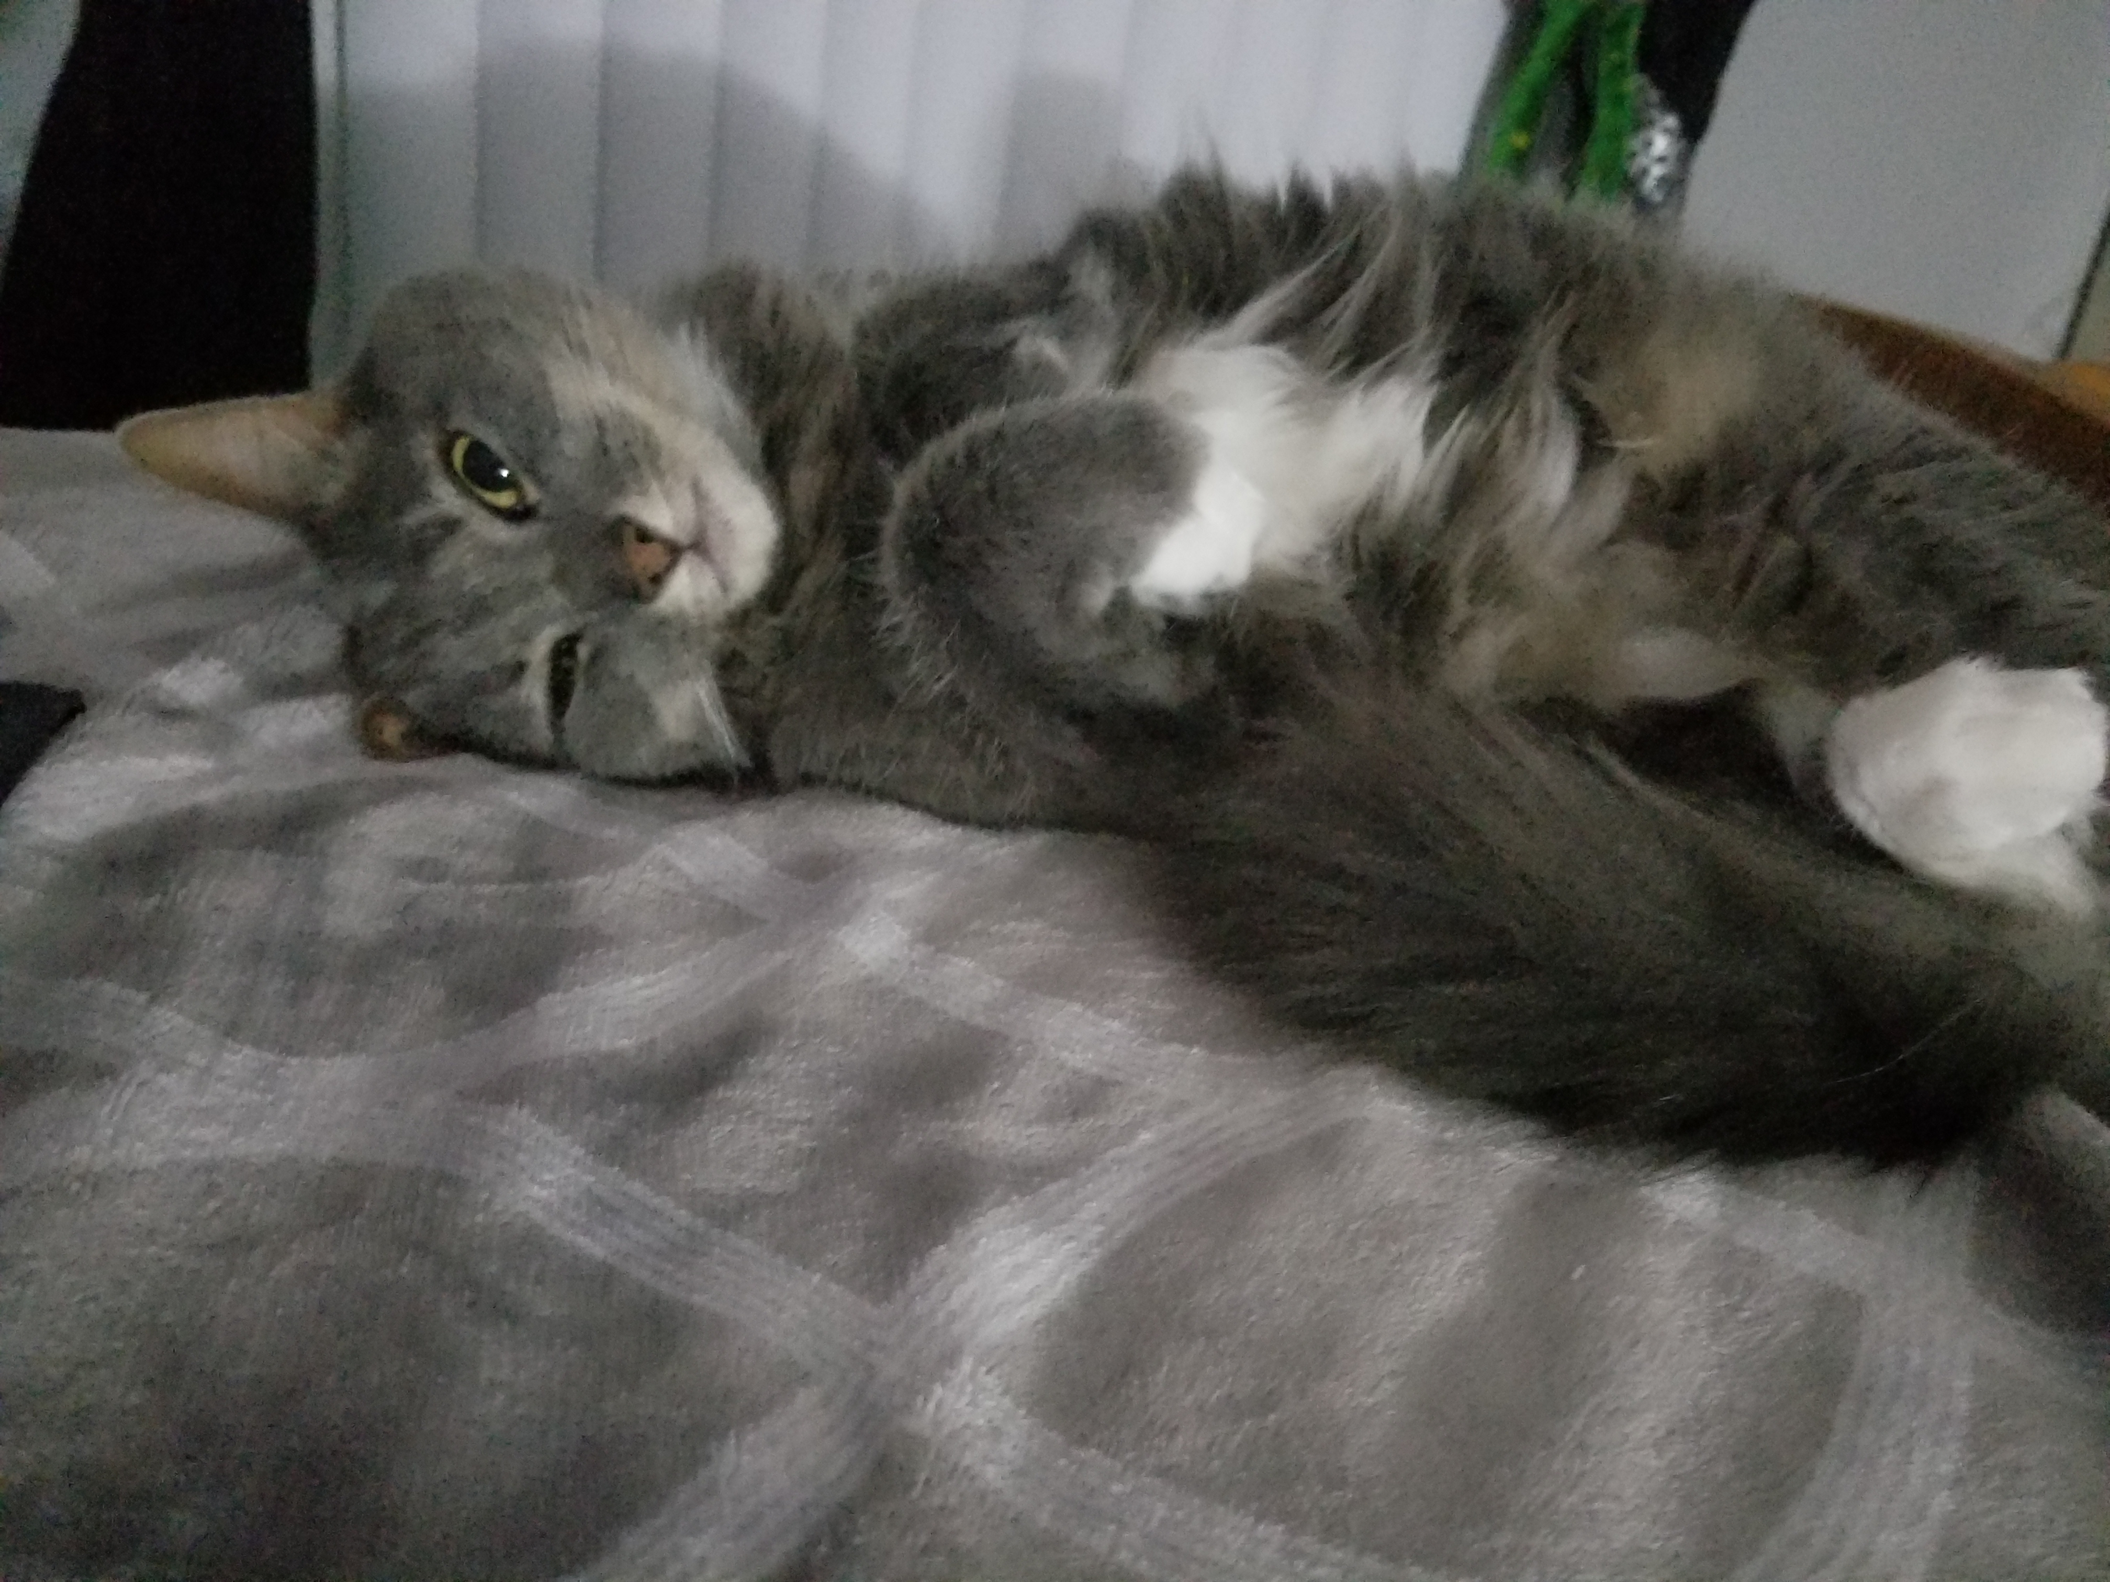
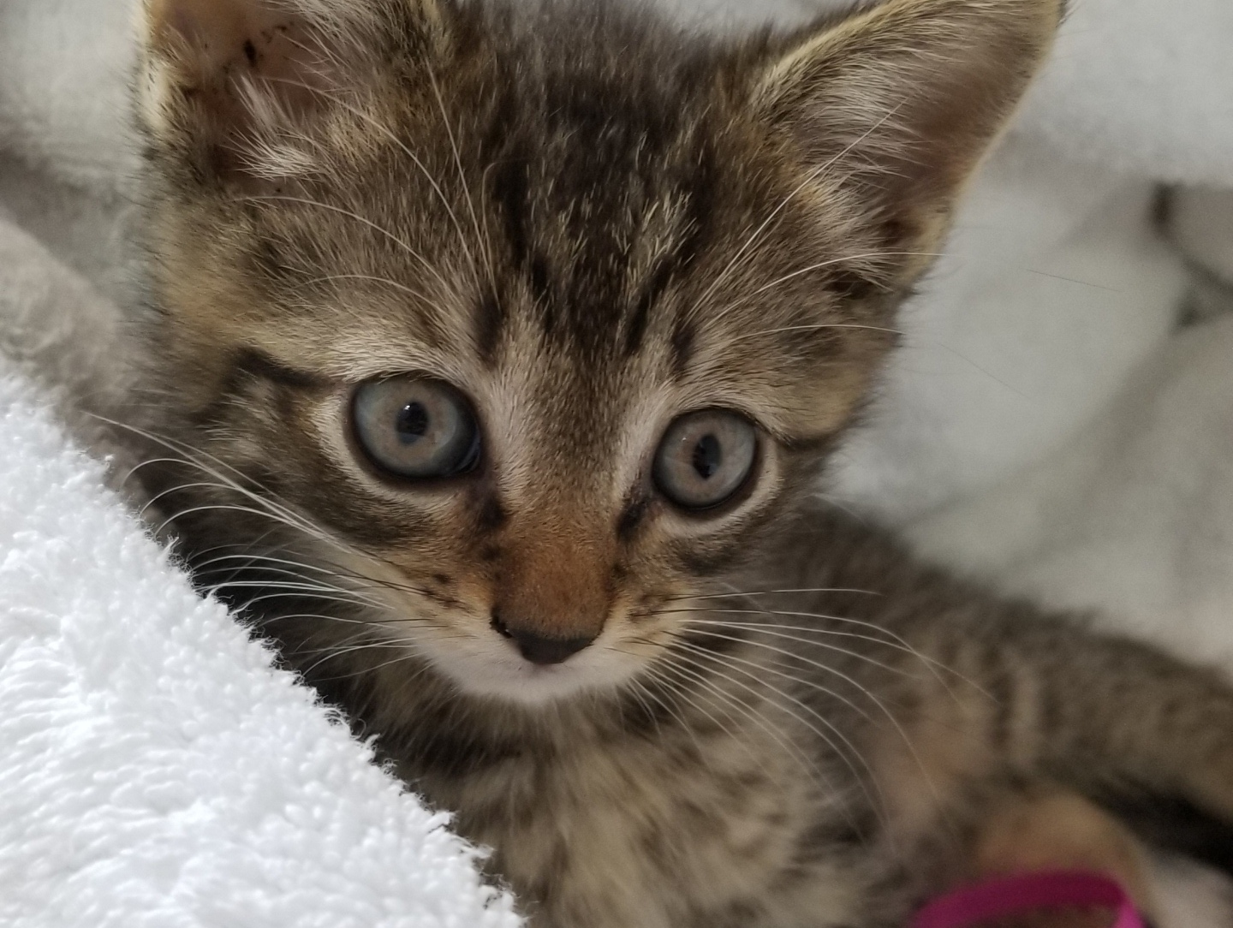
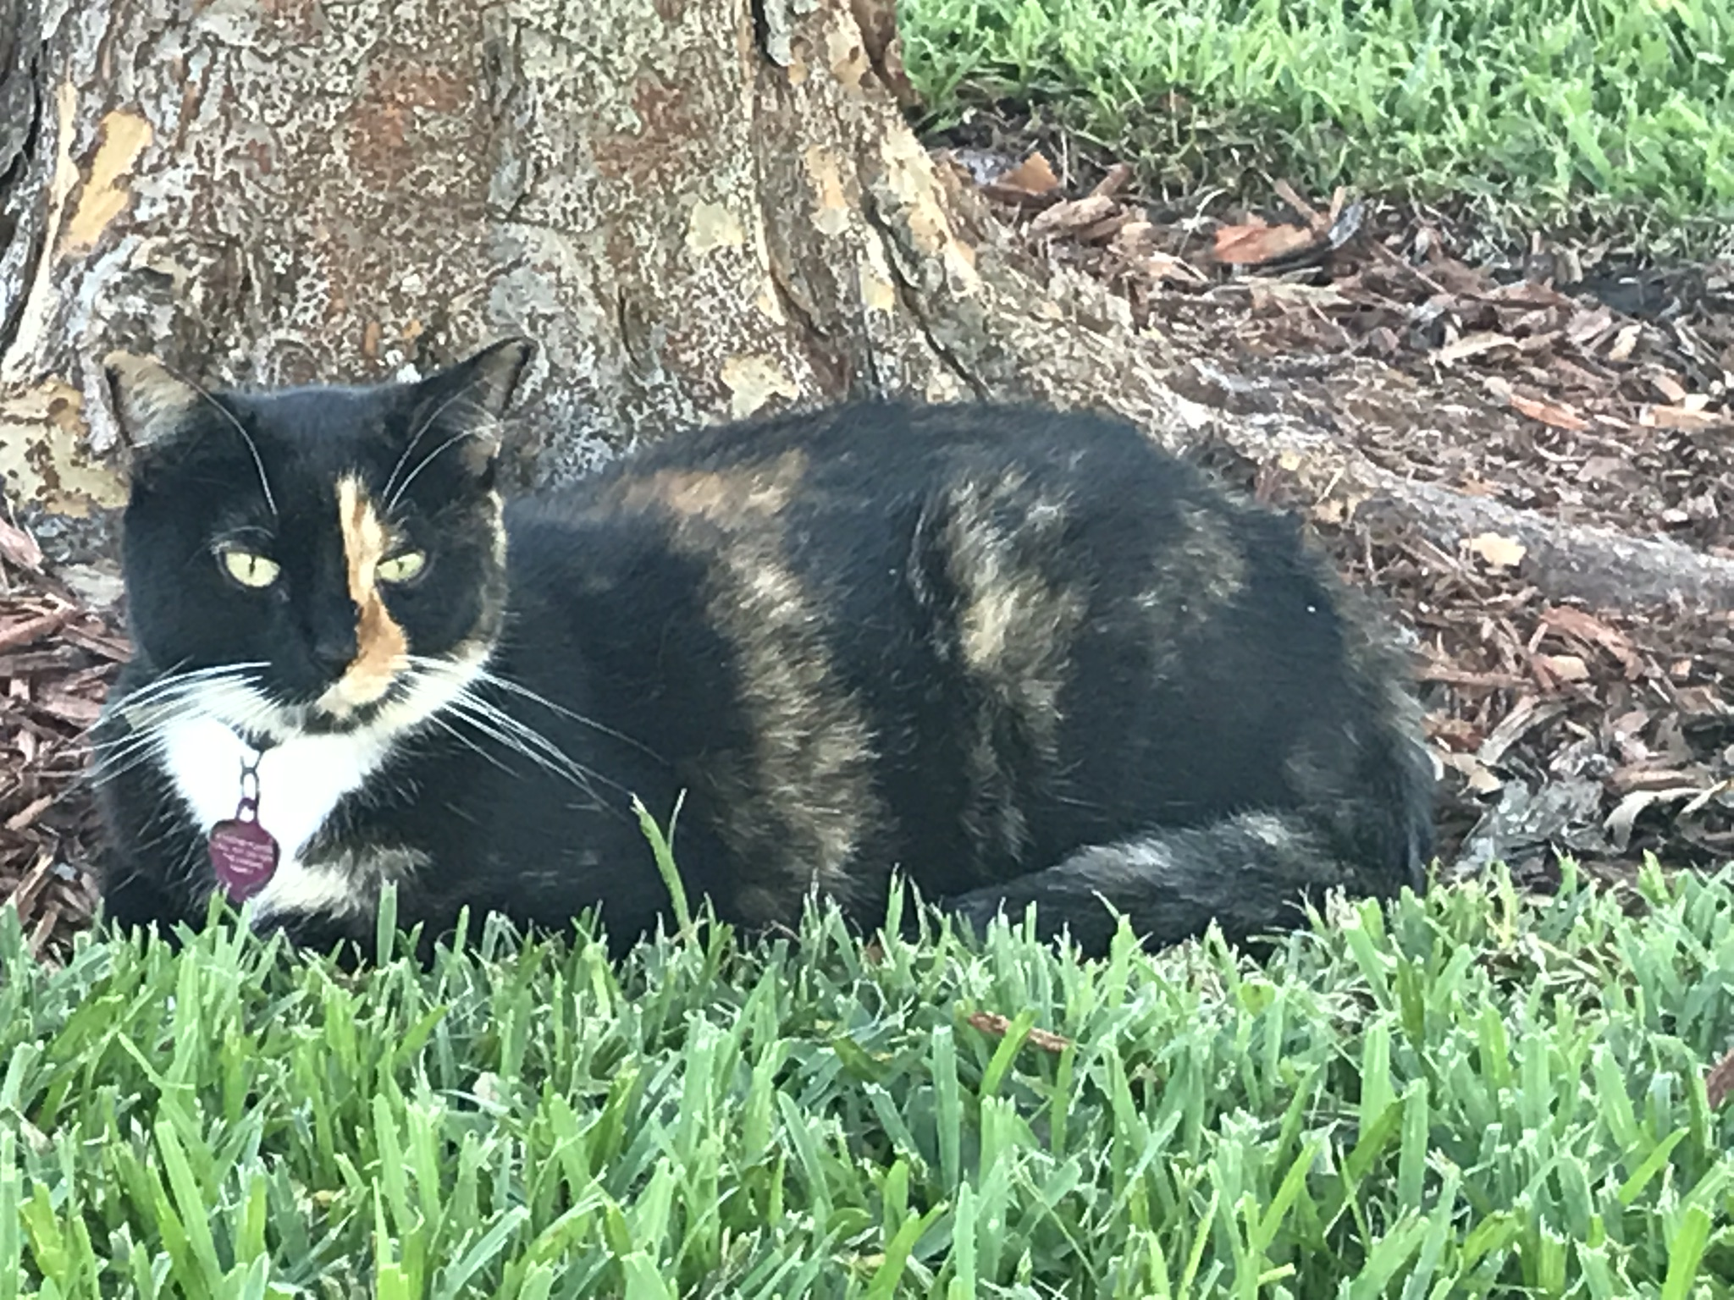
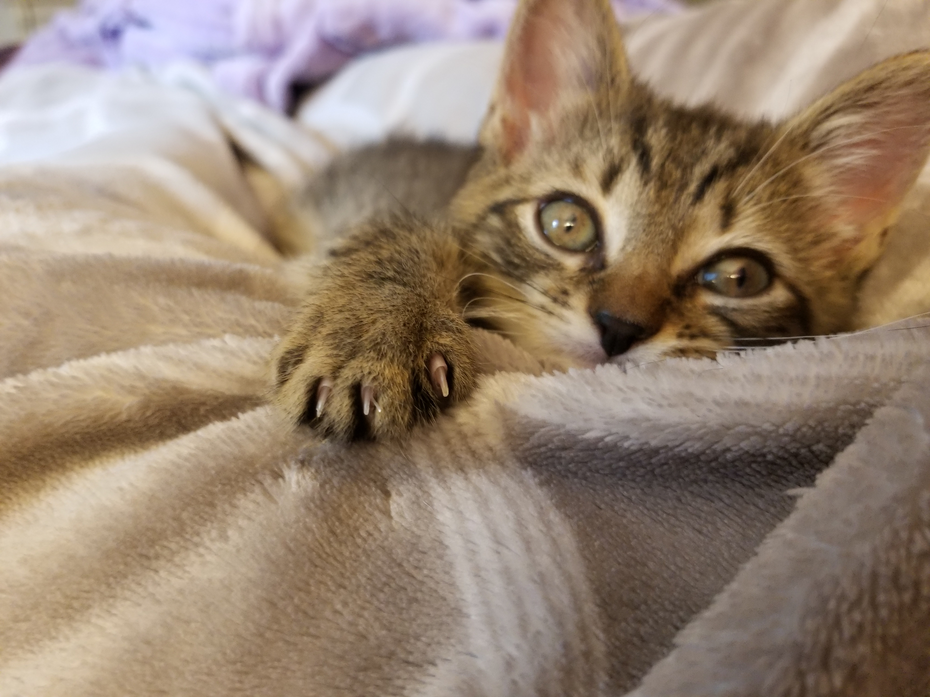
For Our Kitty Friends

Slide 57
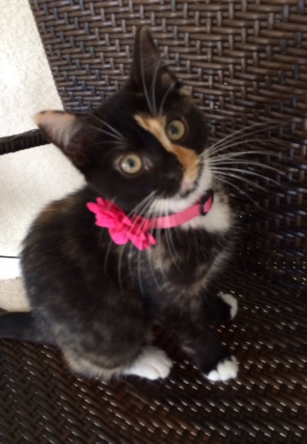
In Loving Memory of Aaliyah
September 2013 – November 2020

Slide 58
Thank you !!!
Special thanks also to:
Dr. Wei and Dr. Richie
Our Sponsor Le Phan
Bob Meizlik, Electrical Design Advisor
Our Seamstress, Grandma Sonja
Notes:
This concludes our presentation… we appreciate you taking your time to watch! Thank you!!!

Slide 59
Interactive Cat Toy
QUESTIONS?

